Slide 1
DSE5002 Project 1
Analysis of Data Science Salaries to Inform future hiring decisions
Peter Gyorda
April 18, 2025

Slide 2
Table of Contents
Table of Contents
Business Need, Project Objectives and Scope
Project Approach
Analysis and Conclusions

Slide 3
Business Need, Project Objectives and Scope
My company CEO would like an analysis of Data Scientist salaries to inform their hiring decisions
My company’s CEO has decided that the company needs a full-time data scientist, and possibly a team of them in the future
She thinks she needs someone who can help drive data science within then entire organization and could potentially lead a team in the future
She understands that data scientist salaries vary widely across the world and is unsure what to pay them. To complicate matters, salaries are going up due to the great recession and the market is highly competitive
My CEO has asked you to prepare an analysis on data science salaries and provide them with a range to be competitive and get top talent. The position can work offshore, but the CEO would like to know what the difference is for a person working in the United States
Projective Objectives
Perform an Analysis of current data scientist salaries to understand the best options for the company to hire a data scientist and potentially a larger team in the near future
Make a recommendation to the CEO on what the best path should be for the company

Slide 4
Project Approach
We propose a traditional approach to analyzing data science salaries using the following workflow
The project entailed data acquisition, processing through a series of steps and performing exploratory analysis using Python coding language. After the analysis is complete, the final results are communicated to senior management utilizing graphics packages embedded in Python
Data Acquisition and Collection
Data Cleaning and Processing
Exploratory Data Analysis
Communication and Visualization of Results
Detailed Approach
Step
Step
2
Step
3
Step
1
4

Slide 5
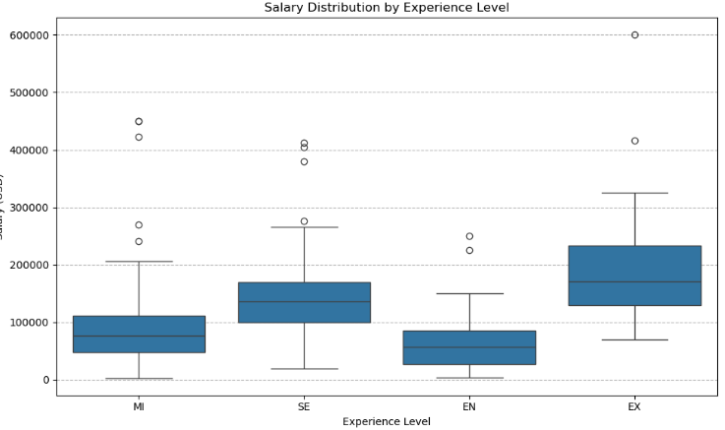
Data Analysis
Average Salaries by experience level
The file of Data Scientist salaries was analyzed using python. There were 607 salaries analyzed across various geographic regions, experience levels and size of companies employing the Data Scientists. All salary information was converted into US $ and is represented below.
Table 1. Average salary by level
Experience level | Average salary | Low end of range | Upper end of range
Entry Level (EN) | $61,643 | $27,505 | $85,425
Mid Level (MI) | $87,996 | $48,000 | $112,000
Senior Level (SE) | $138,617 | $100,000 | $170,000
Expert Level (EX) | $199,392 | $130,006 | $233,750
NOTE: “Low end of range” and “Upper end of range” is the lower end and upper end of the quartile range represented in the box plots.

Slide 6
Data Analysis
Average Salaries by country
There were 50 countries listed in the data set and we have provided the 10 countries with highest average salary and the 10 countries with lowest average salary.
Table 2. Top 10 Countries with highest average salary
Table 3. Bottom 10 Countries with lowest average salary
Country | Average salary | Low end of range | Upper end of range
Russia | $157,500 | $121,250 | $193,750
United States | $144,055 | $100,000 | $170,000
New Zealand | $125,000 | $125,000 | $125,000
Israel | $119,059 | $119,059 | $119,059
Japan
Australia
UAE
Algeria
Iraq
Canada
Country | Average salary | Low end of range | Upper end of range
Turkey | $61,643 | $27,505 | $85,425
Honduras | $87,996 | $48,000 | $112,000
Brazil | $138,617 | $100,000 | $170,000
American Samoa | $199,392 | $130,006 | $233,750
Moldova
Ukraine
Pakistan
Kenya
Iran
Vietnam

Slide 7
Project Approach
We propose a three-step approach to assessing the analysis of the Data Science industry
Align on Project objectives and secondary market research
Data Analysis and Plan
Final Assessment of data analysis
1
2
3
Detailed Approach
Hold kick off meeting and align on project objectives and timeline
Conduct management interviews (up to five) to understand clients perspectives
Perform secondary research on Pathology workflow and perform analysis of steps across Histology process , key bottlenecks findings
Summarize all secondary research findings and develop frameworks to be validated through Primary market research
Align on objectives of outreach campaign
Come up with initial list of key ex-employees, end users and KOLs to reach out too
Develop discussion guides to be used to evaluate each group
Conduct interviews with Pathologists (5-6 ), Lab Directors (5-6), end users/KOL’s (~10), competitors in the market (5-7)
Provide client with weekly updates based on progress from each set of interviews
Summarize secondary research and provide to client
Review of Secondary and market research findings
Alignment on secondary and primary research findings in the Pathology Workflow:
Pathology Workflow analysis
Systems and data integration analysis
Stakeholder mapping
Digital Pathology Evolution
Differences in Operational models
US versus international market considerations
Final recommendation and presentation

